Slide 1
AUTOMATIC CAR PARKING SYSTEM
UNDER THE GUIDANCE OF: PRESENTED BY:
M.ANITHA MADAM M.NIKHILESH REDDY(R170925)
ASSISTANT PROFESSOR G.PAVAN KALYAN(R170912)
DEPARTMENT OF ECE M.VICTOR KRUPANAND(R170982) RGUKT,RK VALLEY

Slide 2
Contents
Abstract
Introduction
Block Diagram
Overview of the components
Working
Advantages
Disadvantages
Applications
Simulation
Conclusion
Reference

Slide 3
Abstract:
The system automatically detects whether the parking slot is empty or not.
If the slot is empty in the automated car parking the new vehicles are allowed to enter else the entrance is blocked by the servo barrier in case the parking is full.
The visitors can see the status for the availability of the free space outside the parking on a 16×2 LCD.
They can also see on the LCD that how many parking slots are free. The data keeps updating as the vehicles move in and out of the parking.

Slide 4
Introduction:
At Present,the number of vehicles has expanded, parking space in Indian cities has remained constant or reduced due to a growing population.
Especially when land is limited and expensive, like in metropolises, rising parking demand spaces puts immense pressure on it.
In this Arduino based automatic car parking system,the empty space in parking area is being monitored by the servomotor based on the number of vehicles entering and leaving the parking slot

Slide 5
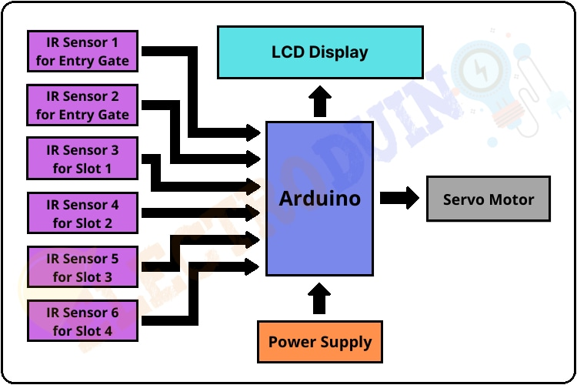
Block Diagram:

Slide 6
Components Used
Arduino
IR sensor
Proteus
Servo motor
Arduino IDE
16×2 LCD Display
Resistors-1k,10k
Power Supply-5v

Slide 7
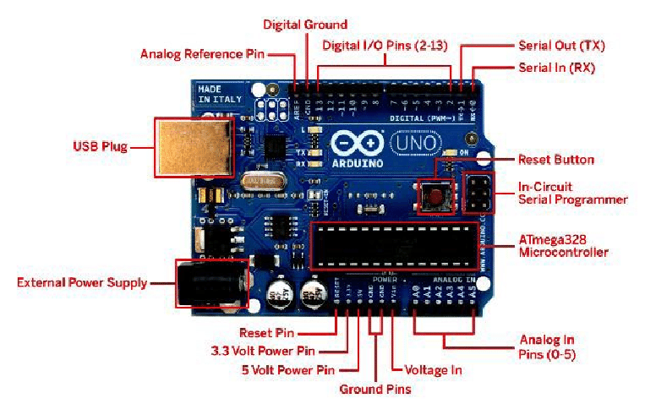
ARDUINO:

Slide 8
ARDUINO:
The arduino Uno is an open source microcontroller board based on the Microchip ATmega328p microcontroller and developed by arduino.cc
We can control arduino board functions by sending a set of instructions to the microcontroller on the board via Arduino IDE.
Arduino boards are able to read analog or digital input signals from different sensors and turns it into an output.

Slide 9
Features of Arduino Uno Board:
Operating Voltage=5v.
Input Voltage ranges from 6v to 20v.
14 Digital I/O pins.
6 Analog input pins
Flash memory is 32 KB.
SRAM is 2KB.
Clock speed is 16 MHZ.

Slide 10
IR SENSOR:
IR sensor is an electronic device, that emits the light in order to sense some object of the surroundings. An IR sensor can measure the heat of an object as well as detects the motion.
IR sensors are now widely used in motion detectors, which are used in building services to switch on lamps or in alarm systems to detect unwelcome guests.

Slide 11
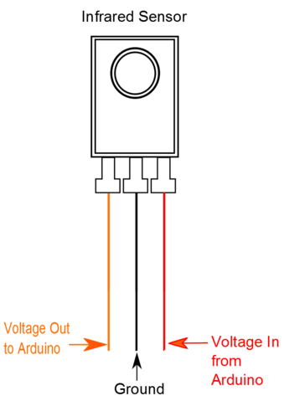
IR SENSOR:

Slide 12
PROTEUS:
The Proteus Design Suite is a proprietary software tool suite used primarily for electronic design automation.The Microcontroller simulation in Proteus works by applying either a hex file or a debug file to the microcontroller part on the schematic.
It is then co-simulated along with any analog and digital electronics connected to it.

Slide 13
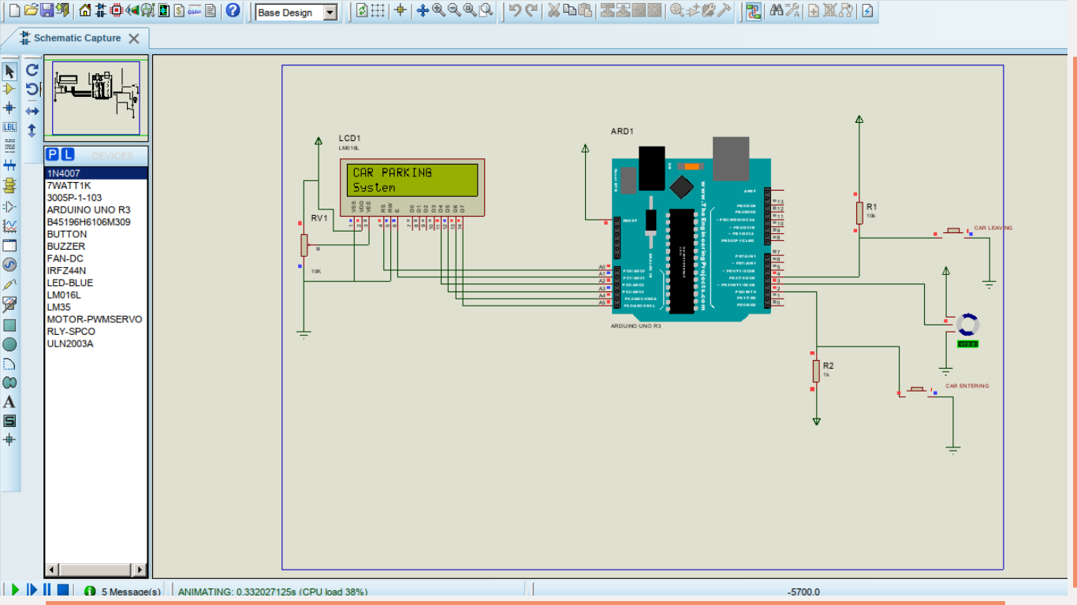
Proteus Software:

Slide 14
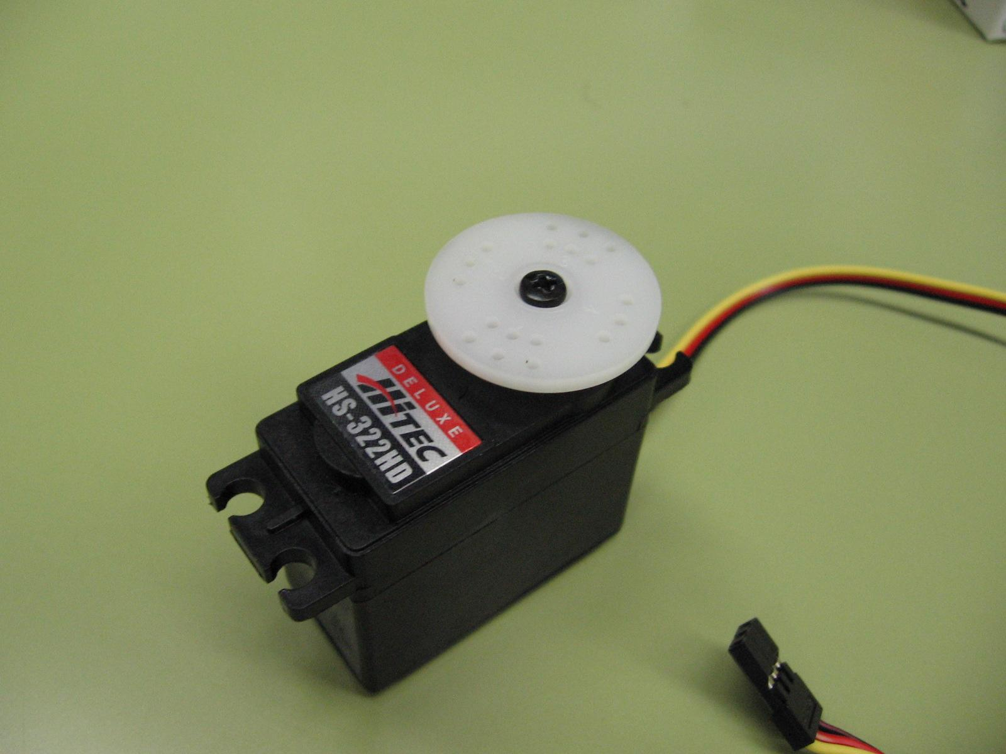
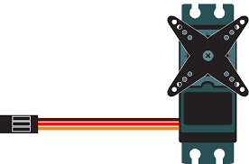
SERVO MOTOR:
A servo motor (or servo motor) is a simple electric motor, controlled with the help of servomechanism.It is a linear actuator or rotary actuator that allows for precise control of linear or angular position, acceleration, and velocity. It consists of a motor coupled to a sensor for position feedback.

Slide 15
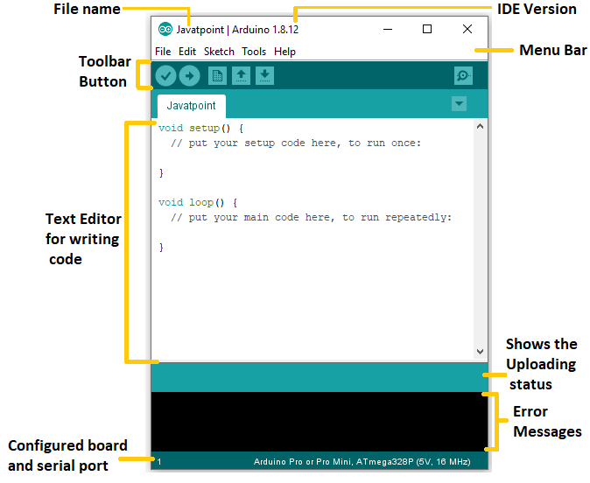
ARDUINO IDE:
The open-source Arduino Software (IDE) makes it easy to write code and upload it to the board. This software can be used with any Arduino board.

Slide 16
LCD Display:
LCD (Liquid Crystal Display) is a type of flat panel display which uses liquid crystals in its primary form of operation.
LCD uses a liquid crystal to produce a visible image. Liquid crystal displays are super-thin technology display screens that are generally used in laptop computer screens, TVs, cell phones, and portable video games.

Slide 17
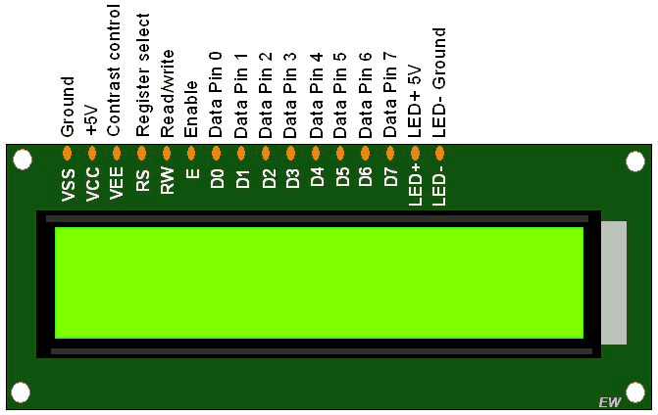

Slide 18
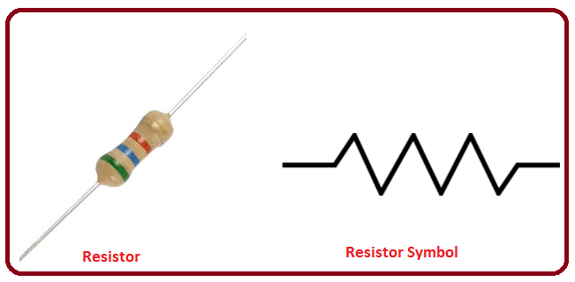
Resistor:
A resistor is a passive two-terminal electrical component that implements electrical resistance as a circuit element. In electronic circuits, resistors are used to reduce current flow.

Slide 19
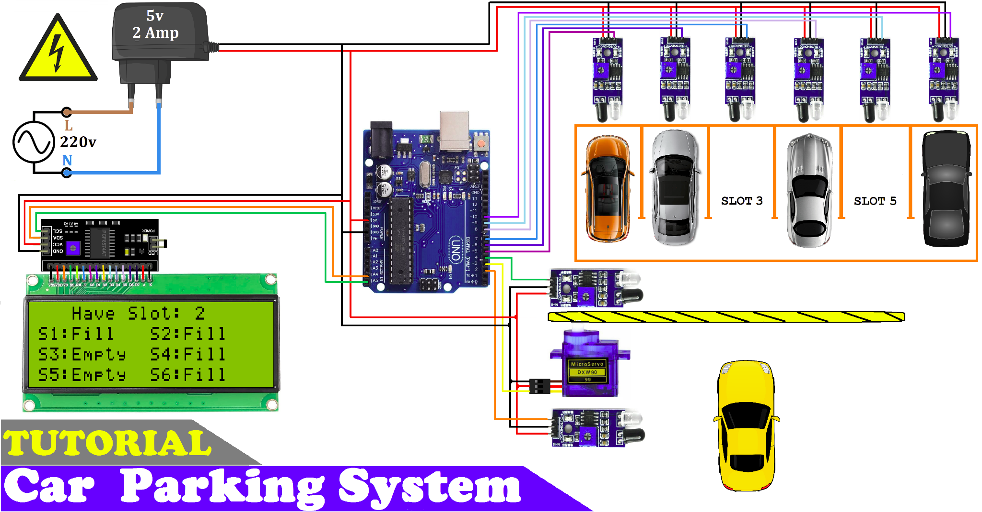
Working:

Slide 20
Advantages:
There is high parking efficiency.
Emissions are greatly brought down and reduced.
There is a greater sense of security .
There is a minimal staff requirement.
There are less chances of traffic.

Slide 21
Disadvantages:
The high cost of construction or installation
Regular maintenance
Breakdown

Slide 22
Simulation:

Slide 23
Conclusion:
The various types of smart parking system and has been presented.With the study on all the sensor technologies used in detecting vehicles,which are one of the most crucial parts of the smart parking system, the pros and cons of each sensor technologies can be analyzed.

Slide 24
Reference:
A Research Report of the school of Mathematical and Computer Science Of Heriot Watt University
https://create.arduino.cc/projecthub/embeddedlab786/au-tomatic-car-parking-system-95a9dc.
International Journal of Research Publication and Reviews Vol (2) Issue (8) (2021) Page 721-724

Slide 25


